Slide 1

Linear regression with one variable
Sukanta Ghosh
Asst. Professor

Slide 2
Why do we use Regression Analysis?
Regression estimates the relationship between the target and the independent variable.
It is used to find the trends in data.
It helps to predict real/continuous values.
By performing the regression, we can confidently determine the most important factor, the least important factor, and how each factor is affecting the other factors.

Slide 3
Terminologies Related to the Regression Analysis:
Dependent Variable: The main factor in Regression analysis which we want to predict or understand is called the dependent variable. It is also called target variable.
Independent Variable: The factors which affect the dependent variables or which are used to predict the values of the dependent variables are called independent variable, also called as a predictor.
Outliers: Outlier is an observation which contains either very low value or very high value in comparison to other observed values. An outlier may hamper the result, so it should be avoided.
Multicollinearity: If the independent variables are highly correlated with each other than other variables, then such condition is called Multicollinearity. It should not be present in the dataset, because it creates problem while ranking the most affecting variable.
Underfitting and Overfitting: If our algorithm works well with the training dataset but not well with test dataset, then such problem is called Overfitting. And if our algorithm does not perform well even with training dataset, then such problem is called underfitting.

Slide 4
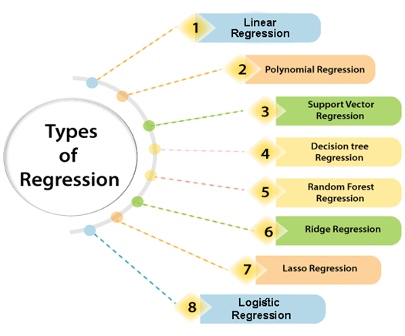

Slide 5
Linear Regression
Linear regression is a statistical regression method which is used for predictive analysis.
It is one of the very simple and easy algorithms which works on regression and shows the relationship between the continuous variables.
It is used for solving the regression problem in machine learning.
Linear regression shows the linear relationship between the independent variable (X-axis) and the dependent variable (Y-axis), hence called linear regression.
If there is only one input variable (x), then such linear regression is called simple linear regression. And if there is more than one input variable, then such linear regression is called multiple linear regression.
The relationship between variables in the linear regression model can be explained using the below image. Here we are predicting the salary of an employee on the basis of the year of experience.

Slide 6
Linear Regression
One Independent Variable is used to make a prediction
Approximates Linear relationship between independent and dependent variables.
Independent
Variable X
Prediction
Dependent Variable Y

Slide 7
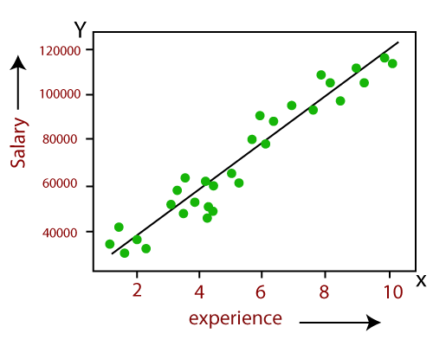
Linear Regression

Slide 8
Linear Regression
Dependent Variable Y can be calculated as:
Y = b₀ + b₁.X
Here, Y = dependent variables (target variables),
X= Independent variables (predictor variables),
Where is b₀ intercept and b₁ is Slope. (linear coefficients)

Slide 9
Types of Linear Regression
Simple Linear Regression:
If a single independent variable is used to predict the value of a numerical dependent variable, then such a Linear Regression algorithm is called Simple Linear Regression.
Multiple Linear regression:
If more than one independent variable is used to predict the value of a numerical dependent variable, then such a Linear Regression algorithm is called Multiple Linear Regression.

Slide 10
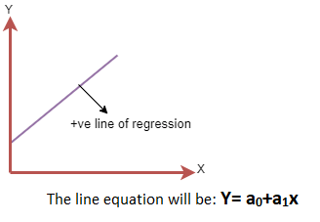
Linear Regression Line
Positive Linear Relationship:
If the dependent variable increases on the Y-axis and independent variable increases on X-axis, then such a relationship is termed as a Positive linear relationship.

Slide 11
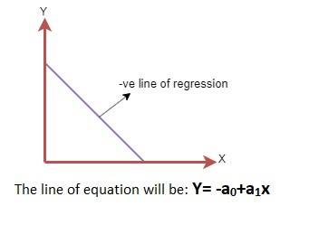
Linear Regression Line
Negative Linear Relationship:
If the dependent variable decreases on the Y-axis and independent variable increases on the X-axis, then such a relationship is called a negative linear relationship.

Slide 12

Model Representation

Slide 13
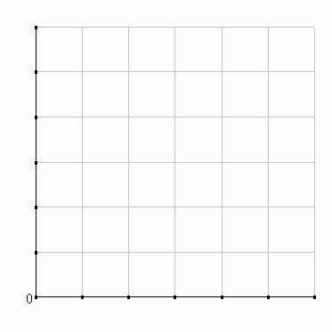
Model Representation
Supervised Learning:
Given the right answer for each example in the data.
Regression Problem:
Predict real valued output
60
50
X
X
X
40
X
Price (Lac)
X
30
X
X
X
20
X
10
500
1000
1500
2000
2500
3000
1300
Area (Sq. Ft.)

Slide 14
Training set of housing prices
Size (in feet²) (x)
Price (in Lacs) (y)
Notation:
2104
1416
1534
852
……..
80
62
68
27
……..
m = Number of training examples
x’s = “input” variable / features
y’s = “output” variable / “target” variable
(x, y) = one training example
(x_{i}, y_{i}) = i^{th} training example

Slide 15
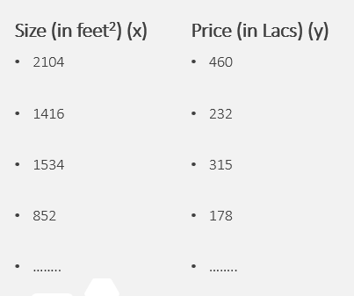
Question
Consider the training set shown below. (xi, yi) is the ith training example. What is y³?
68

Slide 16
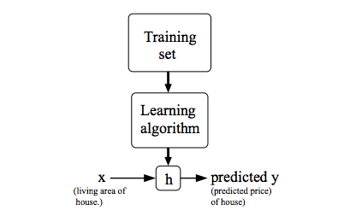
Model Representation
How do we represent h?
h_{Ø}(x) = Ø₀ + Ø₁X ,also written as: h(x)
Mostly, we start with a linear equation, as linear equations are easy to work upon and simpler in nature.
Here, we are predicting house price (y) on the basis on a single linear value of area of living house (x). Hence it is termed as Linear Regression or Linear Regression with one variable or Univariate Linear Regression.
We increase the complexity by adding more decision input variables and generate more complex models.
A machine learning hypothesis is a candidate model that approximates a target function for mapping inputs to outputs.

Slide 17
Revision
x(i) to denote the “input” variables (living area in this example), also called input features.
And y(i) to denote the “output” or target variable that we are trying to predict (price).
A pair (x(i),y(i)) is called a training example, and the dataset that we’ll be using to learn—a list of m training examples (x(i),y(i));i=1,...,m—is called a training set.

Slide 18
Cost Function

Slide 19
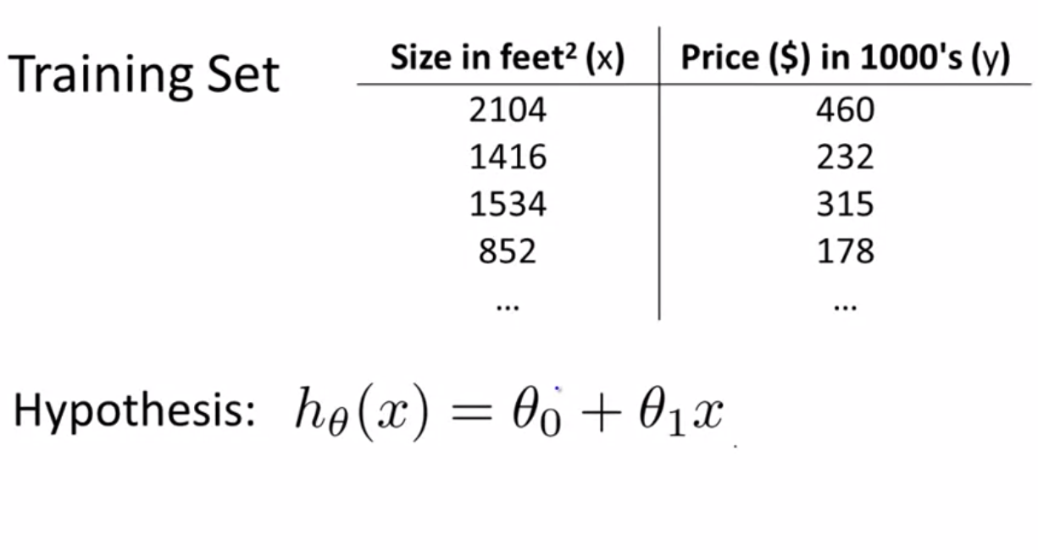
Cost Function
How to fit the best possible straight line to our data?
Here m is 47.
Theta’s in this equations are called parameters of the model.
So, the aim here is to choose the parameters (theta's).

Slide 20
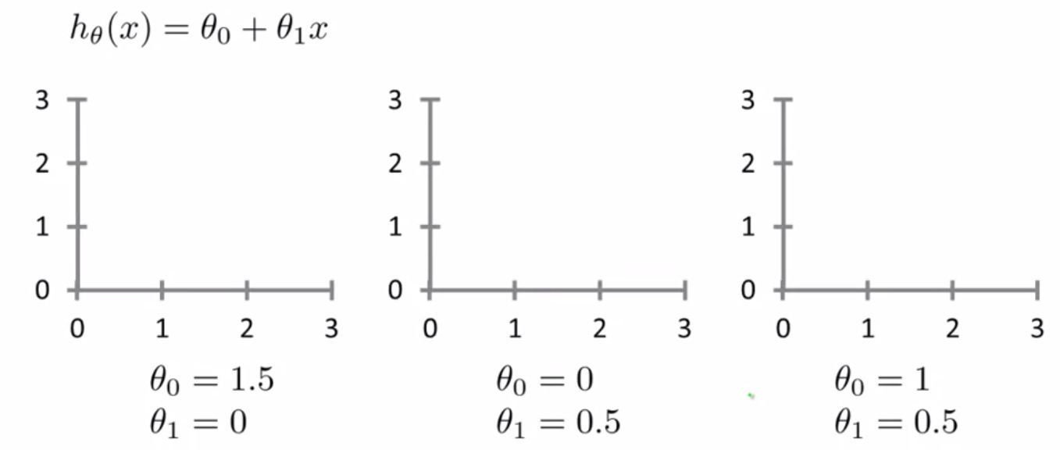
Cost Function
h(x) = 1.5 * (0*x)
h(x) = 0.5*x
h(x) = 1 * 0.5x

Slide 21
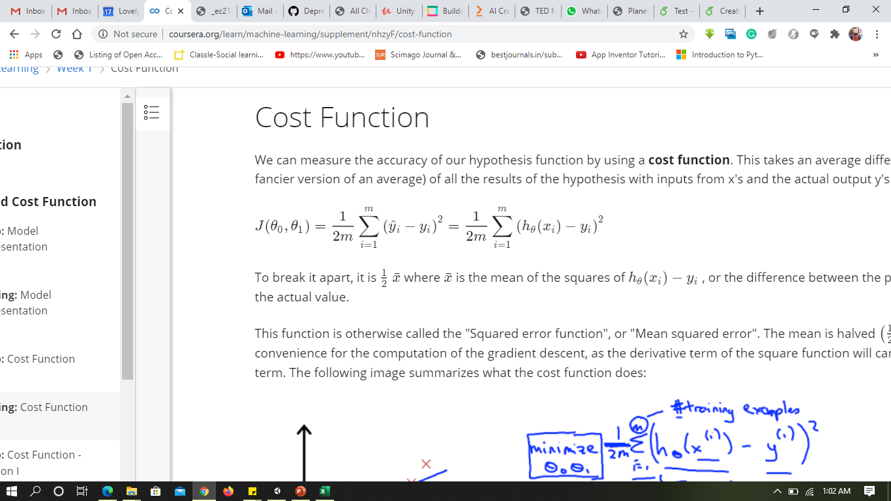
Cost Function
60
Idea: Choose (Ø₀,Ø₁), so that h_{Ø}(x) is close to y for the training example (x,y).
In order to achieve this we are going to solve a minimization problem. {Min - (Ø₀,Ø₁)}
Find the values of theta zero and theta one so that the average, the 1 over the 2m, times the sum of square errors between my predictions on the training set minus the actual values of the houses on the training set is minimized.
So this is going to be the overall objective function for linear regression.
50
X
X
X
40
X
X
X
Actual Value
30
X
X
(Ø₀,Ø₁)
#Training Set
Predicted Value
X
20
X
10
500
1000
1500
2000
2500
3000
Y

Slide 22
To sum up all lets rewrite the equation:
Objective is to Minimize Ø₀,Ø₁ on J(Ø₀,Ø₁) {Cost Function or Squared error function}
Why do we take the squares of the errors?
Because these squared error cost function is a reasonable choice and works well for problems for most regression programs.
There are other cost functions that will work pretty well.
But the square cost function is probably the most commonly used one for regression problems.

Slide 23
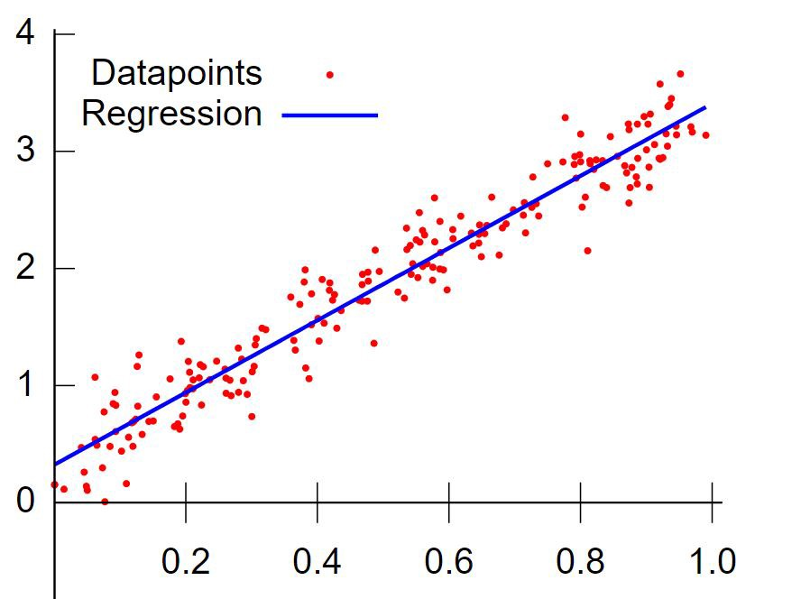
Story upto this point
Linear Regression: it is a linear model that establishes the relationship between a dependent variable y(Target) and one or more independent variables denoted X(Inputs).
Goal is to find that blue straight line (which is best fit) to the data.
In math we have an equation which is called linear equation
y = mX+b { m->slope , b->Y-intercept }
How do we get the m and b values ??
How do we know exact m and b values for the best fit line??
We assume the value of m and b, and, draw a line.
That line is not fitting well to the data so we need to change m and b values to get the best fit line.
How do we change m and b values for the best fit line??
Gradient Descent or Least Square Method

Slide 24
Cost Function - Intuition
If we try to think of it in visual terms, our training data set is scattered on the x-y plane.
We are trying to make a straight line (defined by h_{Ø}(x)) which passes through these scattered data points.
Our objective is to get the best possible line.
The best possible line will be such so that the average squared vertical distances of the scattered points from the line will be the least.
Ideally, the line should pass through all the points of our training data set. In such a case, the value of J(Ø0, Ø1) will be 0.

Slide 25
Linear regression with Multiple Variables

Slide 26
Multiple Linear Regression
In Multiple Linear Regression models the linear relationship between a single dependent continuous variable and more than one independent variable is calculated.
it takes more than one predictor variable to predict the response variable.
Eg. Prediction of CO2 emission based on engine size and number of cylinders in a car.
Note:
For MLR, the dependent or target variable(Y) must be the continuous/real, but the predictor or independent variable may be of continuous or categorical form.
Each feature variable must model the linear relationship with the dependent variable.
MLR tries to fit a regression line through a multidimensional space of data-points.

Slide 27
MLR equation
Y_{i} = Ø₀ + Ø₁X₁ + Ø₂X₂ + ……..+ Ø_{n}X_{n}

Slide 28
Assumptions for Multiple Linear Regression
A linear relationship should exist between the Target and predictor variables.
The regression residuals must be normally distributed.
MLR assumes little or no multicollinearity (correlation between the independent variable) in data

Slide 29
Implementation of Multiple Linear Regression model using Python

Slide 31




Thank You
Sukanta Ghosh
+91-8699583576
Sukanta.19539@lpu.co.in

